Slide 1
Digital Image Fundamentals
Elements of Visual Perception
Human vision and the physical limitations of human vision.
- Structure of the Human Eye

Slide 3
Digital Image Fundamentals
Pattern vision is afforded by the distribution of discrete light receptors over the surface of the retina.
There are two classes of receptors:
- cones
- rods
Cones – 6 to 7 million in each eye, are located in the central portion of the retina called fovea, and are highly sensitive to color.

Slide 4
Digital Image Fundamentals
Cone vision is called photopic or bright-light vision.

Slide 5
Digital Image Fundamentals
rods – 75 to 150 million are distributed over the retinal surface.
rods serve to give a general, overall picture of the field of view.
They are not involved in color vision and are sensitive to low levels of illumination.
Objects that appear brightly colored in daylight when seen by moonlight appear as colorless forms because only the rods are stimulated.

Slide 6
Digital Image Fundamentals
This phenomenon is known as scotopic or dim-light vision.

Slide 8
Digital Image Fundamentals
The above figure shows the density of rods and cones.
The absence of receptors in this area results in the so-called blind spot. Except for this region, the distribution of receptors is radially symmetric about fovea.
Image Formation in the Eye

Slide 10
Digital Image Fundamentals
Brightness Adaptation and Discrimination
The eye’s ability to discriminate between different intensity levels because digital images are displayed as a discrete set of intensities.
The range of light intensity levels to which the human visual system can adapt- from the scotopic threshold to the glare limit. (10¹⁰ ).

Slide 11
Digital Image Fundamentals
Experimental evidence indicates that subjective brightness (intensity as perceived by human visual system) is a logarithmic function of the light intensity incident on the eye.
The figure shows, a plot of light intensity versus subjective brightness.

Slide 12
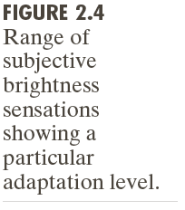

Slide 13
Digital Image Fundamentals
The long solid curve represents the range of intensities to which the visual system can adapt.
In photonic vision alone, the range is about 10⁶ .
the visual system cannot operate over such

Slide 14
Digital Image Fundamentals
Brightness discrimination
The ability of eye to discriminate between changes in light intensity at any specific adaptation level is also considerable interest.
A classic experiment used to determine the ability of the human visual system for brightness discrimination consists of having a subject look at a flat, uniformly illuminated area large enough to occupy the entire field of view.

Slide 16
Digital Image Fundamentals
To the opaque glass(field) is added an increment of illumination, I, in the form of a short-duration flash that appears as a circle in the center of the uniformly illuminated field.
If I is not bright enough, the subject says “no” indicating no perceivable change. As I gets stronger, the subject give a positive response of “yes” indicating a perceived change.

Slide 17
Digital Image Fundamentals
The quantity I_{c} /I, where I_{c} is the increment of illumination discriminable 50% of the time with background illumination I, is called the Weber ratio.
A small value of I_{c} /I, means that a small percentage change in intensity is discriminable. This presents “good” brightness discrimination.

Slide 18
Digital Image Fundamentals
Conversely, a large value of I_{c} /I, means that a large percentage change in intensity is required. This represents “poor” brightness discrimination.

Slide 19
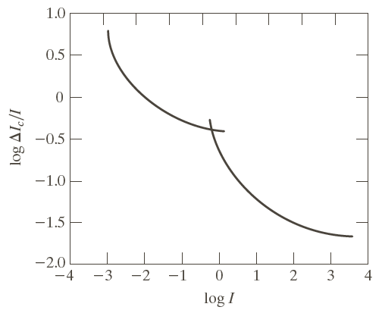

Slide 21
Digital Image Fundamentals
This curve shows that brightness discrimination is poor ( the Weber ratio is large) at low levels of illumination, and it improves significantly (the Weber ratio decreases) as background illumination increases.
Light and the Electromagnetic Spectrum

Slide 22
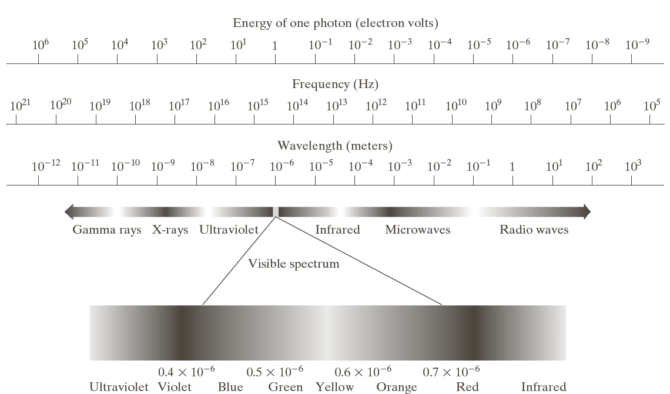

Slide 23
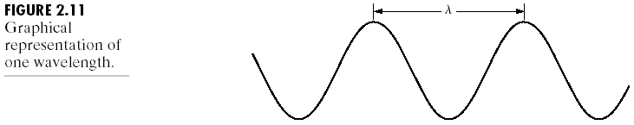

Slide 24
Digital Image Fundamentals
Image Acquisition Using Sensor Arrays
A typical sensor for these cameras is a CCD array, which can be manufactured with a board range of sensing properties and can be packaged in rugged arrays of 4000×4000 elements or more.
CCD sensors are used widely in digital cameras and other light sensing instruments.

Slide 25
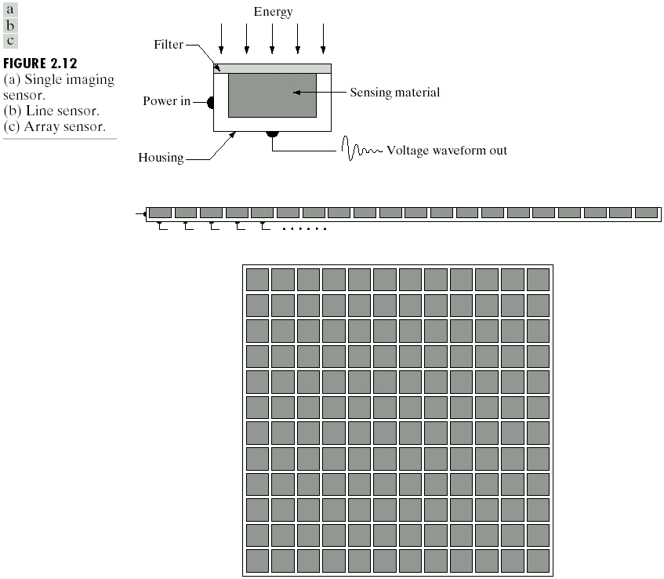
Chapter 2: Digital Image Fundamentals

Slide 26
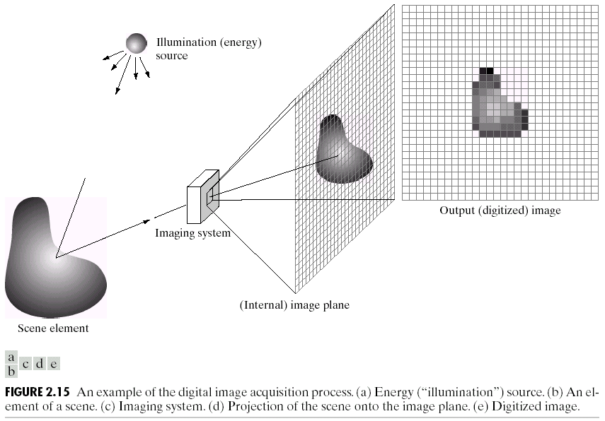
Chapter 2: Digital Image Fundamentals

Slide 27
Digital Image Fundamentals
A Simple Image Formation Model
We denote images by two dimensional function of the form f( x, y)
The value or amplitude of f at spatial coordinates (x, y) is a positive scalar quantity whose physical meaning is determined by the source of the image.
We consider gray scale/monochromatic image.
When an image is generated from a physical process, its value are proportional to energy radiated by a physical source (electromagnetic waves)

Slide 28
Digital Image Fundamentals
A Simple Image Formation Model
When an image is generated from a physical process, its value are proportional to energy radiated by a physical source (electromagnetic waves), as a consequence, f(x,y) must be nonzero and finite, e.i
The function f(x, y) may be characterized by two components:
The amount of source illumination incident on the scene being viewed, and
the amount of illumination by the objects in the scene.

Slide 29
Digital Image Fundamentals
A Simple Image Formation Model
These are called the illumination and reflectance components, denoted by i(x, y) and r(x, y)
Two functions combine as a product to form f(x, y)
Where
and
(1)
(2)
(3)

Slide 30
Digital Image Fundamentals
A Simple Image Formation Model
Where
and
Equation (3) indicates that reflectance is bounded by 0 (total absorption) and 1 (total reflectance).
The nature of i(x, y) is determined by the illumination source, and r(x,y) by the characteristics of the imaged objects.
(1)
(2)
(3)

Slide 31
Digital Image Fundamentals
A Simple Image Formation Model
Where
and
Example: chest X-ray
(1)
(2)
(3)

Slide 32
Digital Image Fundamentals
A Simple Image Formation Model
The intensity of a monochrome image at any coordinate
From eq. (1) through (3) , it is evident that l lies in the range
is the positive and on that it be finite
(4)
(5)

Slide 33
Digital Image Fundamentals
A Simple Image Formation Model
The interval is called gray scale.
Common practice is to shift this interval numerically to the interval where l = 0 is considered as black and is considered as white in the gray scale.
All intermediate values are shades of gray varying from black to white.
white
black

Slide 34
Digital Image Fundamentals
Image Sampling and Quantization
The output of most sensors is a continuous voltage waveform whose amplitude and spatial behavior are related to the physical phenomenon being sensed.

Slide 35
Digital Image Fundamentals
Image Sampling and Quantization
To create a digital image, we need to convert the continuous sensed data into digital form.
This involves two processes:
- sampling
- quantization

Slide 36
Digital Image Fundamentals
Basic Concepts in Sampling and Quantization
The following figure – 2.16(a) shows a continuous image, f(x, y), that we want to convert to digital form.
An image may be continuous with respect to the x- and y-coordinates, and also in amplitude.

Slide 37
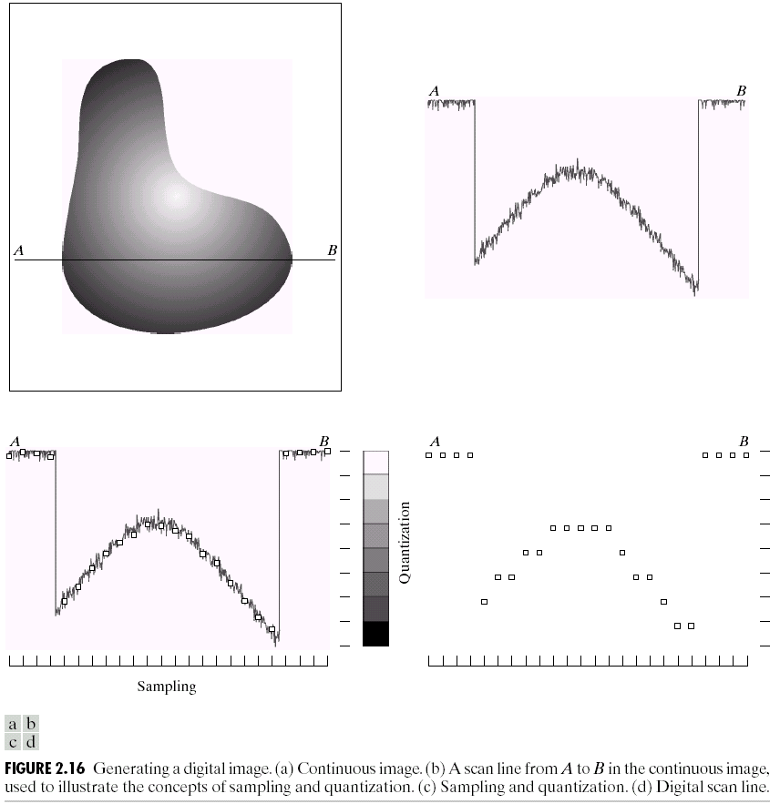
Chapter 2: Digital Image Fundamentals

Slide 38
Digital Image Fundamentals
Basic Concepts in Sampling and Quantization
To convert it to digital form, we have to sample the function in both coordinates and in amplitude.
Digitizing the coordinate values is called sampling.
Digitizing the amplitude values is called quantization.

Slide 39
Digital Image Fundamentals
Basic Concepts in Sampling and Quantization
The one-dimensional function shown in figure 2.16(b) is a plot of amplitude (gray level) values of the continuous image along the line segment AB in figure 2.16(a).
The random variations are due to image noise.

Slide 40
Digital Image Fundamentals
Basic Concepts in Sampling and Quantization
The right side o figure 2.16(c) shows the gray-level scale divided into eight discrete levels, ranging from black to white.
The quality of a digital image is determined to a large degree by the number of samples and discrete gray levels used in sampling and quantization.

Slide 41
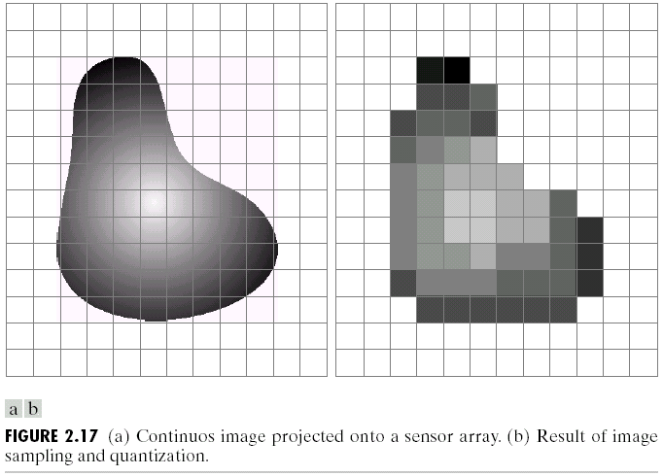
Chapter 2: Digital Image Fundamentals

Slide 42
Digital Image Fundamentals
Representing Digital Images
The result of sampling and quantization is a matrix of real number.
An image f(x, y) is sampled so that resulting digital image has M rows and N columns.
The values of the coordinates (x, y) now becomes

Slide 43
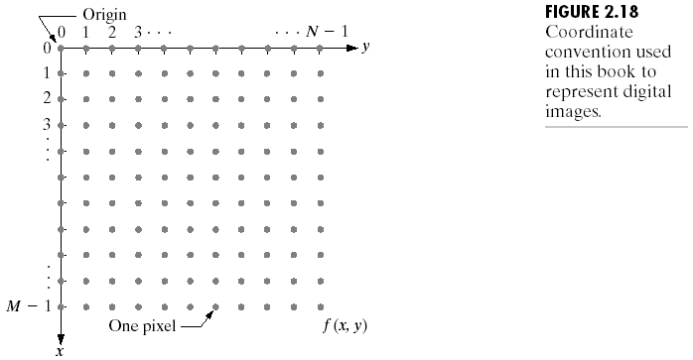
Chapter 2: Digital Image Fundamentals

Slide 44
Chapter 2: Digital Image Fundamentals
The complete M × N digital image in the following
Compact matrix form:

Slide 45
Chapter 2: Digital Image Fundamentals
A more traditional matrix notation to denote digital image
and its elements :
Clearly, above two matrices are identical because

Slide 46
Digital Image Fundamentals
Representing Digital Images
Digitization process requires decisions about the values for M, N and number of discrete gray levels L,
the number of gray levels typically is an integer power of 2:

Slide 47
Digital Image Fundamentals
Representing Digital Images
The number of bits, b, required to store a digitized image is
when M=N, this equation becomes

Slide 48
Digital Image Fundamentals
Representing Digital Images
The following table shows the number of storage bits for various values of N and k

Slide 49
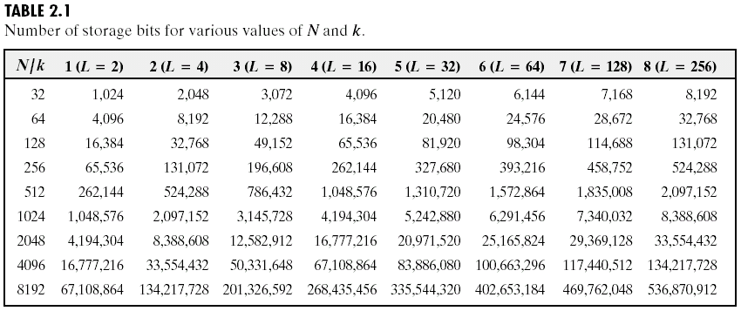
Chapter 2: Digital Image Fundamentals

Slide 50
Digital Image Fundamentals
Spatial and Gray-level Resolution
Sampling is the principal factor determining of an image.
Basically, spatial resolution is the smallest discernable detail in an image.
For example how many lines per millimeter.

Slide 51
Digital Image Fundamentals
Spatial and Gray-level Resolution
Gray-level resolution refers to the smallest discernable change in the gray level

Slide 52
Digital Image Fundamentals

Slide 55
Digital Image Fundamentals
Aliasing
If the function is sampled at a rate equal to or greater than twice its highest frequency, it is possible to recover completely the original function from its samples.
If the function is undersampled, then a phenomenon called aliasing corrupts the sampled image.

Slide 56
Digital Image Fundamentals
Zooming and Shrinking Digital Images
Zooming may be viewed as oversampling, while shrinking may be viewed as undersampling.
Zooming requires two steps:
- the creation of new pixel locations and
- the assignment of gray levels to those new locations.

Slide 57
Digital Image Fundamentals
Zooming Digital Images
Suppose that we have an image of size 500×500 pixels and we want to enlarge it 1.5 times to 750×750 pixels.
Conceptually, one of the easiest ways to visualize zooming is laying an imaginary 750×750 grid over the original image.

Slide 58
Digital Image Fundamentals
Zooming Digital Images
Obviously, the spacing in the grid would be less than one pixel because we are fitting it over a smaller image.
In order to perform gray-level assignment for any point in the overlay, we look for the closest pixel in the original image and assign its gray-level to the new pixel in the grid.

Slide 59
Digital Image Fundamentals
Zooming Digital Images
When we are done with all points in the overlay grid, we simply expand it to the original specified size to obtain the zoomed image.
This method of gray-level assignment is called nearest neighbor interpolation.

Slide 60
Chapter 2: Digital Image Fundamentals

Slide 61
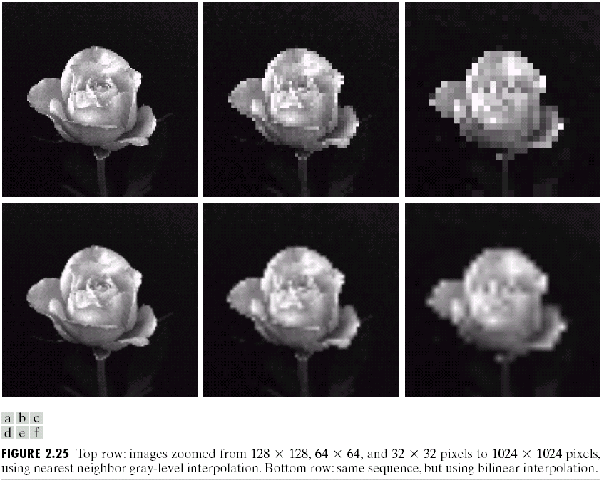
Chapter 2: Digital Image Fundamentals

Slide 62
Digital Image Fundamentals
Zooming Digital Images
Pixel replication is a special case of nearest neighbor interpolation.
Pixel replication is applicable when we want to increase the size of an image an integer number of times.

Slide 63
Digital Image Fundamentals
Zooming Digital Images
For instance, to double the size of an image, we can duplicate each column.
This doubles the image size in the horizontal direction.
Then, we duplicate each row of the enlarged image to double the size in the vertical direction.

Slide 64
Digital Image Fundamentals
Zooming Digital Images
The same procedure is used to enlarge the image by any integer number of times.
Duplication is just done the required number of times to achieve the desired size.

Slide 65
Digital Image Fundamentals
Zooming Digital Images
Although nearest neighbor interpolation is fast, it has undesirable feature that it produces a checkerboard effect that is particularly objectionable at high factor of magnification.
A slightly more sophisticated way of accomplishing gray-level assignment is Bilinear interpolation using the four nearest neighbors of a point.

Slide 66
Digital Image Fundamentals
Zooming Digital Images
Bilinear interpolation:
Let denotes the coordinates of a point in the zoomed image, and let denote the gray level assigned to it.
For bilinear interpolation, the assigned gray level is given by

Slide 67
Digital Image Fundamentals
Zooming Digital Images
Bilinear interpolation:
For bilinear interpolation, the assigned gray level is given by
Where the four coefficients are determined from the four equations in the four unknowns that can be written using the four nearest neighbors of point

Slide 68
Digital Image Fundamentals
Shrinking Digital Images
Image shrinking is done in a similar manner as just described for zooming.
The equivalent process of pixel replication is row-column deletion.

Slide 69
Digital Image Fundamentals
Some Basic Relationships Between Pixels: An image is denoted f(x, y) and a particular pixel denotes as p and q
Neighbors of a Pixel
A pixel p at coordinates (x, y) has four horizontal and vertical neighbors whose coordinates are given below:

Slide 70
Digital Image Fundamentals
Neighbors of a Pixel
This set of pixels, is called the 4-neighbors of p, is denoted by
 | X,
x-1, y | x, y | x+1, y
 | x, y+1
x, y-1
p

Slide 71
Digital Image Fundamentals
Neighbors of a Pixel
Each pixel is a unit distance from (x, y), and some of the neighbors of p lie outside the digital images if (x, y) is on the border of the image.
 | X,
x-1, y | x, y | x+1, y
 | x, y+1
x, y-1
p

Slide 72
Digital Image Fundamentals
Neighbors of a Pixel
The four diagonal neighbors of p have coordinates
and denoted by
 | X,
x-1, y | x, y | x+1, y
x-1,y+1 | x, y+1 | x+1,y+1
x-1,y-1
x, y-1
x+1,y-1
p

Slide 73
Digital Image Fundamentals
Neighbors of a Pixel
These points, together with 4-neighbors, are called 8-neighbors of p, denoted
Some of the points in fall outside the image if (x,y) is on the border
 | X,
x-1, y | x, y | x+1, y
x-1,y+1 | x, y+1 | x+1,y+1
x-1,y-1
x, y-1
x+1,y-1
p

Slide 74
Digital Image Fundamentals
Adjacency, Connectivity, Regions, and Boundaries
Connectivity is a fundamental concepts that simplifies the definitions of regions and boundaries.
To established if two pixels are connected, it must be determined if they are neighbors and if their gray levels satisfy a specified criterion of similarity (say, if their gray levels are equal)

Slide 75
Digital Image Fundamentals
For instance, in a binary image with values 0 and 1, two pixels may be 4-neighbors , but they are said to be connected only if they have same value.
Adjacency: Let V be the set of gray level values used to define adjacency. In a binary image, V={1} if we are referring to adjacency of pixels with value 1. V tipically contains more elements.

Slide 76
Digital Image Fundamentals
Adjacency: we consider three types of adjacency.
4-adjacency: two pixels p and q with values from V are 4-adjacent if q is in the set
8-adjacency: two pixels p and q with values from V are 8-adjacent if q is in the set

Slide 77
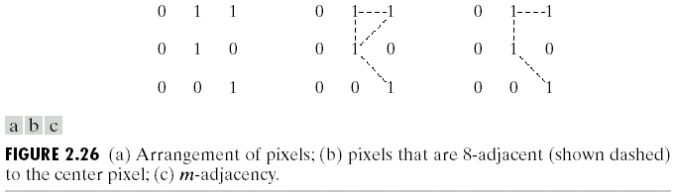
Chapter 2: Digital Image Fundamentals

Slide 78
Digital Image Fundamentals
Two image subsets S₁ and S₂ are adjacent if some pixels in S₁ is adjacent to some pixels in S₂
A (digital) path from pixel p with coordinates (x, y) to pixel q with coordinates (s, t) is a sequence of distinct pixels with coordinates

Slide 79
Digital Image Fundamentals
For example, the path shown in Fig. 2.26(b) between the northeast and southeast points are 8-path and path in 2.26( c ) is an m-path
2.26 (b)
2.26 (c)

Slide 80
Digital Image Fundamentals
Let S represent a subset of pixels in an image. Two pixels p and q are said to be connected in S if there exists a path between them consisting entirely of pixels in S.
For any pixel p in S, the set of pixels that are connected to it in S is called a connected component of S.
If it only has one connected component, then set S is called a connected set.

Slide 81
Digital Image Fundamentals
Let R be a subset of pixels in an image. We call R a region of the image if R is a connected set.
The boundary (also called border or contour) of a region R is the set of pixels in the region that have one or more neighbors that are not in R.
If R happens to be an entire image, then its boundary is defined as the set of pixels in the first and last rows and columns of the image.

Slide 82
Digital Image Fundamentals
The concept of an edge is found frequently in discussions dealing with regions and boundaries.
the idea of an edge is a “local” concept that is based on a measure of gray-level discontinuity at a point.

Slide 83
Digital Image Fundamentals
Distance Measures:
For pixels p, q, and z, with coordinates (x,y), (s, t), and (v, w), respectively, D is a distance function or metric if

Slide 84
Digital Image Fundamentals
Distance Measures:
The Euclidean distance between p and q is defined as
The D₄ distance (also called city-block distance) between p and q is defined as

Slide 85
Digital Image Fundamentals
Distance Measures:

Slide 86
Digital Image Fundamentals
Distance Measures:

Slide 87
Digital Image Fundamentals
Distance Measures:
between p and q are independent of any paths
If we select to consider m-adjacency, however, the D_{m} distance between two points is defined as the shortest m-path between the points.
In this case, the distance between two pixels will depend on the values of the pixels along the path and the values of their neighbors.

Slide 88
Digital Image Fundamentals
Distance Measures:
For example,

Slide 89
Digital Image Fundamentals

Slide 90
Digital Image Fundamentals
Assignment-1:
1)

Slide 91
Digital Image Fundamentals
Assignment-1:
2)

Slide 92
Digital Image Fundamentals
Assignment-1:
3)

